Slide 1


Bank of Baroda Hackathon - 2022
Technology Partner
Your Team Name : The Brain Trust
Your team bio : We use the tech to initiate our idea which is a real world problem and to solve preferably
Date : 18 SEPTEMBER 2022

Slide 2
Problem Statement?
Why did you decide to solve this Problem statement?
Instant Credit: This method provide the instant credit to the customers.
Automatic Payment: It also makes the automatic payment in a efficient way.
Originality: This method also help to check the originality of the cheque.
Authorization: This is beneficial in security of the bank database, to check the authorization.
Employment Decreased: This also helps in adaption of new technology by which manual work is decreased.
Time Management: Also heps in time managment of the employees.
Accessibility: Easily runnable in portable devices. Also allowing quicker access to the digital image of their processed cheques.
Digging-in-Scam: Detecting the potential fraud like Accounting fraud, Demand Draft fraud, Bill Detecting fraud.
Transfer of Funds: Making funds available faster.

Slide 3
User Segment & Pain Points
Which user /advertiser segment would be early adopter of your product & why?
Hospitals
Colleges/Institutions
Banks
MNCs
Charated Accountened
Income Tax Commisioner/ Tax Collector

Slide 4
Pre-Requisite
What are the alternatives/competitive products for the problem you are solving?
A signature verification system
Forgery detection system
Store the data in Bank Database

Slide 5
Azure tools or resources
Azure tools or resources which are likely to be used by you for the prototype, if your idea gets selected Resources used :- Jupyter spyder github DBMS

Slide 6
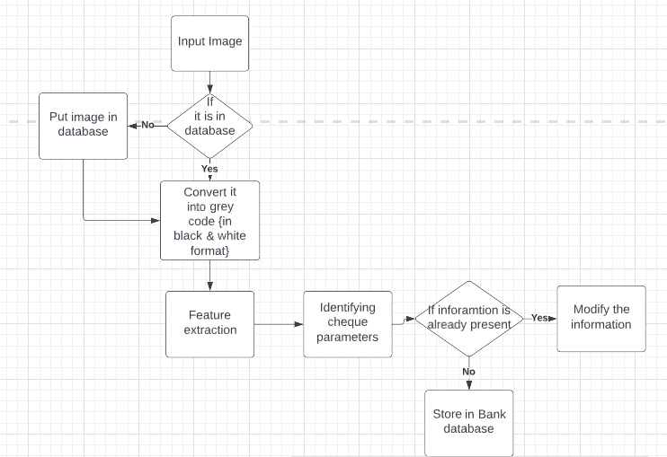
Any Supporting Functional Documents
Present your solution, talk about methodology, architecture & scalability
Methodology :- firstly image convreted to greycode format(black-n-white image) .
-> Then features of image extracted.
->using these features forgery is

Slide 7
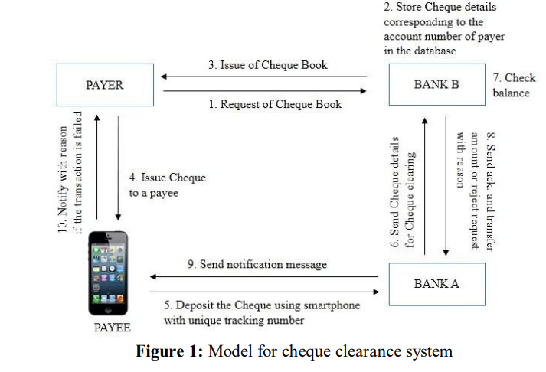
Key Differentiators & Adoption Plan
How is your solution better than alternatives and how do you plan to build adoption?
We consider a scenario where a payer issues a cheque to a payee who is a customer of another bank. There are four role model namely payer, payee, cheque submitting bank (A) and cheque clearing bank (B). Here the payer issues a cheque to a payee. The payee submits that cheque using his smartphone in his servicing bank ‘A’, who submits that cheque for clearance to payer’s servicing bank, B. If the cheque is cleared, funds are transferred from payer’s account to payee’s account. The cheque clearance model has a protocol consisting of the following five steps:
Request for cheque book
Payer fills down the cheque details
The payee can deposit a cheque in a bank by entering the cheque details in the smartphone application or Attach the front and back picture of the cheque.
Verification of cheque
Clearance of cheque

Slide 8
GitHub Repository Link & supporting diagrams, screenshots, if any
How far it can go?
github repository link :- https://github.com/buffy1256/cheque_processing

Slide 9
Thank You
Team member names
Yatika Nagar
Harshit Sharma
Sahil Saxena
Khushi

